Slide 1


‘Rights Respecting’
Curriculum
Nythe Primary School 2025-2026

Slide 2
Together, may our feathers give us wings to soar
Strength Opportunity Aspiration Respect

Slide 3

Our ‘Rights Respecting’ Curriculum
At Nythe Primary School, we use our SOAR values of strength, opportunity, aspiration and respect to support every child in becoming a well-educated global citizen.
A global citizen can be defined as someone who believes in global justice and acts to make the world a safer, fairer and more sustainable place in which human rights are protected and respected.
Global citizenship underpins our curriculum, with this primary driver striving to develop our pupil's awareness of community at local, national and global levels. We promote children's rights and our responsibility to them through the convention on the rights of a child.

Slide 4
Our School House Mottos
Brunel House ‘Innovation through determination’
Swift House ‘Rise above, shine bright’
Rashford House ‘Strength in unity, excellence in action’
Malala House ‘Courage to speak, power to change’

Slide 5
Autumn: Term 1

Slide 6
Broad Curriculum Areas – Term 1
United Nations Rights of Child | Respecting Rights Class Charters created Article 42: All children, young people and adults should know about the convention OPAL Play Charter revised Article 31: Every child has the right to play
Trips and Experiences | Vision and Values Day Grandparents' Day – Yr 1 SS Great Britain Trip – Yr 2 Scarf Online Workshops – Year 1 - 5
Global Citizenship Opportunities | International Day of Democracy – School Council Elections Hello Yellow – World Mental Health Day Diwali Festival Day

Slide 7





Curriculum Area | Swallows | Robins | Woodpeckers | Magpies |  | Kites
Maths (Can-Do) | Year 1 Place Value – up to 100 Properties of Shapes | Year 2 Number Place Value Properties of Shapes Addition & Subtraction Multiplication & Division | Year 3 Number and Place Value Properties of Shapes | Year 4 Number and Place Value Properties of Shapes | Year 5 Number and Place Value Decimals | Year 6 Number and Place Value Multiplication and Division
Literacy Writing | Non Fiction: Write a diary entry | Diary Entry | Recount: Write a letter in role | Write a series of diary entries |  | Story ending
Literacy Reading Spine | Julia Donaldson | Fantastic Mr Fox | Alice's Adventures in Wonderland | Who Let the Gods Out |  | The Light Jar
Science | Seasonal Changes The Seasons Seasonal Vocabulary Weather | Living Things and their Habitats Biomes and Microhabitats | Rocks The Rock Cycle The Process of Fossilisation | Forces Types of Forces Measuring Time Levers, Pulley and Cogs |  | Animals including Humans The Circulatory System/Diet and Lifestyle
History | My History. How can we organise things by age? How is life different for children now than it was when my grandparents were young? | Brunel Who was Isambard Kingdom Brunel and why is he important? How did the building of the Great Western Railway change Swindon? | Ancient Egypt What did the Ancient Egyptians believe? What was life like for people living in Ancient Egypt? | Ancient Greeks What were the achievements of the Ancient Greeks? How do these influence our lives today? |  | World War II What were the causes of WWII and who did it involve? What were the consequences of the conflict for people back home in Britain?

Slide 8
Curriculum Area | Swallows | Robins | Woodpeckers | Magpies | Kites
Art | Drawing: Exploring Line and Shape | Drawing: Understand tone and texture | Drawing: Developing Drawing Skills | Drawing: Exploring tone, texture and proportion | Craft and Design: Photo Opportunity
Music | Unit : Hey You! Style:Old School Hip-Hop | Unit: Hands, Feet, Heart Style: South African styles | Unit: Let Your Spirit Fly Style: R&B | Unit: Livin' On a Prayer Style: Rock | Unit: Happy Style: Pop/Motown
PSHE | Me and my Relationships | Me and my Relationships | Me and my Relationships | Me and my Relationships | Me and my Relationships
Computing | Computing Systems and Networks: Technology all around Us. E-Safety: Self-Image and Identity | Computing Systems and Networks: IT around us​ E-Safety: Self-Image and Identity | Computer Systems and Networks: Connecting Computers E- Safety: Self-Image and Identity | Computer Systems and Networks: Systems and Searching E-Safety: Self-Image and Identity | Computing Systems and Networks: Communication​ and Collaboration E-Safety: Self-Image and Identity

Slide 9
Curriculum Area | Swallows | Robins | Woodpeckers | Magpies | Kites
Religion and Worldviews | Christianity Why is belonging to God and the church family important to Christians? | Judaism Why do Jewish families talk about repentance at New Year? | Christianity How do Christians show that reconciliation with God and others is important? | Christianity How does believing Jesus is their saviour inspire Christians to save and serve others? | Christianity How do Christians show their belief that Jesus is God incarnate?
French | French commences in year 3 |  | Finger rymes and songs Greetings & simple Conversation Classroom instruction Colours Alphabet Spelling Names Numbers 0-3 Listening to stories | Finger rhymes & songs Introduce il y a New vocabulary for masc & fem nouns Introduce adjectival agreement for singular nouns Listening to stories | Finger rhymes & songs Introduce il y a New vocabulary for masc & fem nouns Introduce adjectival agreement for singular nouns Listening to stories
PE | Real P.E Coordination and Balance Real Dance Shapes and circles Partnering and artistry | Real P.E Footwork and one leg balance Real Dance Shapes and circles Partnering and artistry | Real P.E Footwork and one leg balance Real Dance Shapes and circles Partnering and artistry | Real P.E Ball skills and reactions Swindon Academy coaching – invasion games | Real P.E Ball skills and reactions Swindon Academy coaching – invasion games

Slide 10
Autumn: Term 2

Slide 11
Broad Curriculum Areas – Term 2
United Nations Rights of Child | Article 2: Every child has the right to be protected from discrimination.
Trips and Visits | Speak Out Stay Safe NSPCC Assemblies The Little Mermaid at the Watermill Theatre – KS2
Global Citizenship Opportunities | Malala House Day Anti-Bullying Week – Power for Good Remembrance Day Odd Socks Day United Nations World Children’s Day Switch Off Fortnight Carols by Candlelight EYFS Christmas Performance

Slide 12
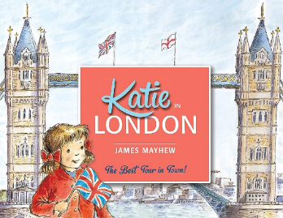

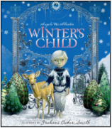

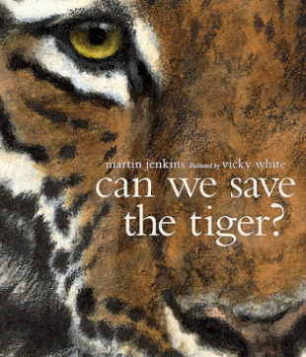
Curriculum Area | Swallows | Robins | Woodpeckers | Magpies |  | Kites
Maths | Year 1 Addition & Subtraction Facts – 11 – 20 Length Fractions Position & Direction | Year 2 Multiplication Tables Length and Mass Fractions Time Money | Year 3 Addition & Subtraction Written Methods Multiplication and Division | Year 4 Multiplication Tables Addition & Subtraction written Methods | Year 5 Addition and subtraction Multiplication & Division Powers of 10 and properties of number | Year 6 Fractions Calculating Angles Ratio & Proportion Converting Units Area & Volume Algebra
English Writing | Non-fiction: write a non-chronological report | Non-chronological report: write a fact sheet About owls | Fiction: Write a fantasy story based on a fable. | Fiction: write a traditional tale with an alternative ending. |  | Information/explanation/ persuasion: write a hybrid booklet about an amazing animal & Recount: diary
Literacy Reading Spine | The Lady Who Swallowed A Fly (Pam Adams) Stinky Cheese Man (Jon Scieszka) | Flat Stanley | Fortunately the Milk | Cosmic |  | Pax
Science | Animals including Humans Animal Groups Our Senses | Properties of Material Changes of Material | Light Light Sources Reflection Shadows | Properties of Materials States of Matter, Electrical Conductors, Processes. Irreversible and Reversible Changes. |  | Evolution and Inheritance Darwin’s Finches Natural Selection Adaptation Evolution Inheritance

Slide 13
Curriculum Area | Swallows | Robins | Woodpeckers | Magpies | Kites
Geography | Nythe How do maps help us? Why does Nythe school need human features? | Australia Describe the similarities and differences between Australia and the UK. Would you want to live in the Outback? | The Alps What is tourism like in the Alps? | Kenya How is sustainable tourism good for the Maasai Mara National Park? Why does sustainable tourism matter? Why should governments travel companies encourage it? | Earthquakes How can Earthquakes can have a long-term impact on the people living there? Can disasters be predicted? Has living in hazardous locations become safer?
DT | Structures: Stable Structures | Structures: Baby Bear's chair | Structures: Wearable Technology | Electrical Systems: Doodlers | Textiles: Bags
Religion and Worldviews | Judaism Mitzvot / tzedakah Why is learning to do good deeds so important to Jewish people? | Christianity Saviour / Jesus Why was Jesus given the name ‘saviour’? | Islam How does a Muslim show their submission and obedience to Allah? | Islam Why do Muslims call Muhammed ‘The Seal of the Prophets’? | Islam How does tawhid create a sense of belonging to the Muslim community?
PSHE | Valuing Difference | Valuing Difference | Valuing Difference | Valuing Difference | Valuing Difference

Slide 14
Curriculum Area | Swallows | Robins | Woodpeckers | Magpies | Kites
Music (Charanga) | Unit: Rhythm In The Way We Walk Style: Reggae, Hip Hop | Unit: Ho Ho Ho Style: Christmas, Big Band, Motown, Elvis, Freedom Songs | Unit: Glockenspiel Stage 1 | Unit: Classroom Jazz 1 Style: Jazz | Unit: Classroom Jazz 2 Style: Jazz, Latin, Blues
Computing | Creating Media: Digital Painting E-Safety: Online Relationships Online Bullying | Creating Media: Digital photography E-Safety: Online Relationships Online Bullying | Creating Media: Stop Frame Animation E-Safety: Online Relationships Online Bullying | Creating Media: Video production E-Safety: Online Relationships Online bullying | Creating Media: Web Page creations E-Safety: Online Relationships Online Bullying
French | French commences in year 3 |  | Simple nouns relating to Christmas Indefinite article –un/une Masculine & feminine Simple sentence building Listening to stories | Oral and written sentence building. Revise days of the week Tenses – it is, it was, it will be Spelling of new nouns Christmas songs and stories Numbers 0-39 Plural nouns and determiners | Oral and written sentence building. Revise days of the week Tenses – it is, it was, it will be Spelling of new nouns Christmas songs and stories Numbers 0-39 Plural nouns and determiners
PE | Real P.E Jumping and landing Seated balances Real Dance Shapes and circles Partnering and artistry | Real P.E Jumping and landing Seated balances Real Dance Shapes and circles Partnering and artistry | Real P.E Jumping and landing Seated balances | Real P.E Ball skills and reactions Swindon Academy coaching – Invasion games | Real P.E Ball skills and reactions Swindon Academy coaching – Invasion Games

Slide 15
Spring: Term 3

Slide 16
Broad Curriculum Areas – Term 3
United Nations Rights of Child | Article 28: Every child has the right to education. Article 17: Every child has the right to get information in lots of ways, as long as it is safe. Article 24: Every child has the right to the best possible health.
Trips and Visits | Fire Safety Workshops
Global Citizenship Opportunities | Children's Mental Health Week Safer Internet Day – Too good to be true? Big School's Bird Watch Chinese New Year Festival Day

Slide 17

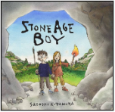
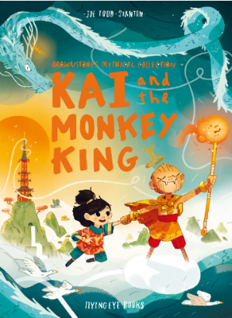

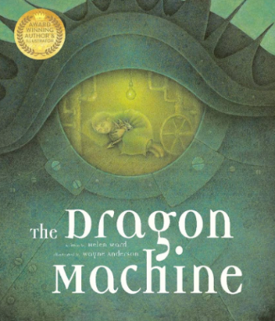
Curriculum Area | Swallows | Robins | Woodpeckers |  | Magpies | Kites
Maths | Read, write and interpret mathematical statements. Compare lengths and heights, mass or weight, capacity & time Measure and record | Multiplication and division Measurement of length and mass Problem solving | Fractions Written methods of addition and subtraction Problem solving | Fractions Written methods of addition and subtraction Problem solving | Multiplication and division written methods Position Direction | Fractions Ratio Proportion Measurement Area Volume
English Writing | Fiction: write a journey story | Fiction: Write an adventure story with change of character and machine | Fiction: Write a historical narrative set in the Stone Age. |  | Fiction: write a myth, creating characters and settings | Recount: write a journal entry from the expedition
Literacy Reading Spine | Six Dinner Sid by Inga Moore) I Want My Hat Bacl by Jon Klassen | The Tale of Peter Rabbit | The World according to Humphrey |  | War Horse | The Girl of Ink and Stars by Kiran Milwood Hargrave
Science | Materials Properties of materials Famous scientists | Animals including humans Adults and their offspring/Characteristics of living things/Exercise, hygiene and diet | Forces and Magnets What is a force? Friction Magnets Famous scientists |  | Space The Solar System Planet, Star, Moon Moon Phases Day and Night Space Capital - Astronauts | Electricity Components of a circuit What is a battery? Common electrical hazards Renewable energy

Slide 18
Curriculum Area | Swallows | Robins | Woodpeckers | Magpies | Kites
History | Mary Anning Who was Mary Anning and what do we know about her life? Why was Mary Anning’s discovery so important? | Space Travel What was the legacy of the first moon landing? How has space travel changed since then? | Stone Age to Iron Age What were the main changes from the Stone to the Iron Age? How did the people of the Stone to Iron Age shape our local area? | Henry VIII and the Reformation What were the Tudors famous for? How did the Reformation change England? | Crime and Punishment How have crimes and punishments changed throughout British history? How did beliefs affect crimes and punishments?
Art | Sculpture and 3D: Paper Play | Painting and Mixed Media: Life in Colour | Craft and Design: Ancient Egyptian Scrolls | Drawing: Depth, emotion and movement | Drawing: Expressing ideas
Religion and Worldviews | Christianity Parables / gospel What did Jesus teach about God in his parables? | Islam Allah / mercy How do some Muslims show Allah is compassionate and merciful? | Hinduism Why do Hindus want to collect good karma? | Hinduism How does the story of Rama and Sita inspire Hindus to follow their Dharma? | Hinduism How do questions about Brahman and atman influence the way a Hindu lives?
PSHE | Keeping Safe | Keeping Safe | Keeping Safe | Keeping Safe | Keeping Safe

Slide 19
Curriculum Area | Swallows | Robins | Woodpeckers | Magpies | Kites
Music (Charanga) | Unit: In The Groove Style: Blues, Latin, Folk, Funk, Baroque, Bhangra | Unit: I Wanna Play In A Band Style: Rock | Unit: Three Little Birds Style: Reggae | Unit: Make You Feel My Love Style: Pop Ballads | Unit: Benjamin Britten - A New Year Carol Style: Benjamin Britten (Western Classical Music), Gospel, Bhangra
Computing | Programming: Moving a Robot | Programming A: Robot Algorithms | Programming A: Sequencing Sounds | Programming A: Selection in Physical Computing | Programming A: Variables in games
French | French commences in year 3 |  | New Year celebrations – La Fete des Rois Commands Simple adverbs Simple conversation Numbers 0-10 | Introduce adverbs of place – sentence starters Introduce new verbs – nager, danser, sauter, voler Sentence building – oral and written, including new verbs and adverbs of place | Introduce adverbs of place – sentence starters Introduce new verbs – nager, danser, sauter, voler Sentence building – oral and written, including new verbs and adverbs of place
PE | Real P.E Dynamic balances and stances Swindon Academy coaching – invasion games | Real P.E – Dynamic balances and stances Swindon Academy coaching – invasion games | Real P.E Dynamic balances and ball skills Real Gym Balance and rotation Flight and travel Swimming | Real P.E Stances and footwork Real Gym Partner work low apparatus | Real P.E Stances and footwork Real Gym Partner work low apparatus

Slide 20
Spring: Term 4

Slide 21
Broad Curriculum Areas – Term 4
United Nations Rights of Child | Article 28: Every child has the right to education. Article 14: Every child has the right to think and believe what they choose.
Trips and Visits | The Big Sleepover – Year 4
Global Citizenship Opportunities | Brunel House Day – STEM focus World Book Day British Science Week: Curiosity. What’s your question? Shakespeare Week

Slide 22

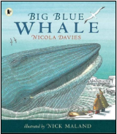


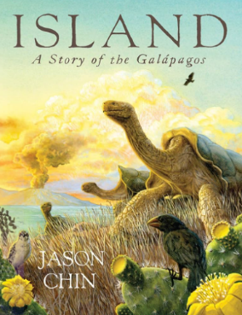
Curriculum Area | Swallows | Robins | Woodpeckers |  | Magpies | Kites
Maths | Addition & subtraction Fractions Geometry Time Problem solving | Fractions Time Money Multiplication Addition and Subtraction | Multiplication Division Measurement Money | Multiplication Division Measurement Money | Fractions Decimals Percentages Length Mass Capacity | Statistics Algebra Geometry Problem solving
English Writing | Fiction: write own version of the story | Recount: write a recount of events from character’s point of view | Persuasion: Write an information article. |  | Recount: write a formal biography of Chris Hadfield | Recount: write a journalistic report (hybrid text) about Charles Darwin’s discoveries
Literacy Reading Spine | The Bear Who Stared by Duncan Beady The Enormous Crocodile by Roald Dahl | The Giraffe and Pelly and me. | The Mousehole Cat |  | Jungle Book | The Lie Tree by Frances Hardings
Science | British Science Week | British Science Week | British Science Week |  | British Science Week | British Science Week

Slide 23
Curriculum Area | Swallows | Robins | Woodpeckers | Magpies | Kites
Geography | UK Which four countries make up the UK? What are the capital cities of the UK? Looking at the human and physical features of the UK. | Hong Kong What environmental problems are there in Hong Kong? How is Hong Kong different to the UK? | South-West England What is it like to live in South-West England? | USA Compare the climate in different locations across the USA. Explain the positives and negatives of tourism in one place in the USA. | Farming in the UK Why does farming matter?
DT | Textiles: Puppets | Mechanisms: Fairground wheel | Structures: Constructing a castle | Mechanical systems: Gears and Pulleys | Structures: Playgrounds
Religion and Worldviews | Christianity Prayer / worship Why do Christians pray to God and worship him? | Christianity What are the best symbols of Jesus’ death & resurrection at Easter? | Christianity Is the cross a symbol of love, sacrifice or commitment for Christians? | Sikhism How does the teaching of the gurus move Sikhs from dark to light? | Buddhism How does the Triple Refuge help Buddhists in their journey through life?
PSHE | Rights and Respect | Rights and Respect | Rights and Respect | Rights and Respect | Rights and Respect

Slide 24
Curriculum Area | Swallows | Robins | Woodpeckers | Magpies | Kites
Music | Unit: Round And Round Style: Latin Bossa Nova, Film music, Big Band Jazz, Mash-up, Latin fusion | Unit: Zootime Style: Reggae | Unit: The Dragon Song Style: Folk Music | Unit: Fresh Prince Of Bel-Air Style: Hip Hop | Unit: You've Got A Friend Style: The Music of Carole King
Computing | Data and Information: Grouping Data | Data and Information: Pictograms | Data and Information: Branching databases | Data and Information: Flat-file databases | Data and information: Spreadsheets
French | French commences in year 3 |  | Vocabulary for School stationery Revision of indefinite article & masc/fem Simple sentence Building, oral and written with conjunction | Months of the year Sequences and tenses – This …is, Last … it was, Next … it will be Introduce adjectives petit & grand, which precede the noun Numbers 0-50 Building simple negatives Dictionary skills | Months of the year Sequences and tenses – This …is, Last … it was, Next … it will be Introduce adjectives petit & grand, which precede the noun Numbers 0-50 Building simple negatives Dictionary skills

Slide 25
Curriculum AreaShapes | Swallows | Robins | Woodpeckers | Magpies | Kites
PE | Real P.E Coordination and counter-balance Swindon Academy coaching – invasion games | Real P.E Ball skills and counterbalance Swindon Academy coaching – invasion games | Real P.E Sending and receiving Counter balance Real Dance Shapes and circles Partnering and artistry | Real P.E Seated balance and floorwork Real Dance Shapes and circles Partnering and artistry | Real P.E - Seated balance and Floorwork Real Dance Shapes and circles Partnering and artistry

Slide 26
Summer: Term 5

Slide 27
Broad Curriculum Areas – Term 5
United Nations Rights of Child | Article 27: Every child has the right to proper food.
Trips and Experiences | Avebury Trip - Year 3 Sports Week
Global Citizenship Opportunities | Rashford House Day

Slide 28
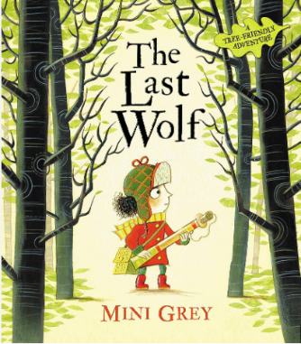
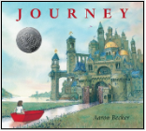


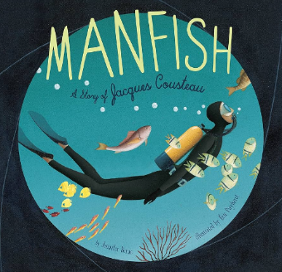
Curriculum Area | Swallows | Robins | Woodpeckers | Magpies |  | Kites
Maths | Year 1 Addition & Subtraction Facts – 11 – 20 Length Fractions Position & Direction | Year 2 Multiplication Tables Length and Mass Fractions Time Money | Year 3 Fractions Time Measurement Length capacity | Year 4 Fractions Time Measurement Length capacity | Year 5 Fractions calculating | Year 6 Fractions calculating Ratio & Proportion Converting Units Area & Volume Algebra
English Writing | Non-fiction: write information about sea animals | Letter: write a letter in role as the character persuading to save the trees | Fiction: Write an adventure story. | Persuasion/information: write an Information leaflet |  | Recount: write a biography of Jacques Cousteau & Fiction: adventure story
English Reading Spine | Jolly Postman Dr Seuss Books | The Frog Prince | The Accidental Prime Minister | Skellig |  | Selection of poems
Science | Plants Seeds and Blubs Conditions for Growth Parts of a flower Evergreen/deciduous trees Common Flowers Types of leaves | Plants Seeds and Bulbs Conditions for growth Lifecycle of a sunflower Plants in different climates Famous botanists | Animals including humans What do we need to survive and be healthy? The Skeletal System Characteristics of living things Muscles in the body | Living Things and Habitat Animal reproduction and life cycles Sexual reproduction in plants Asexual reproduction in plants Scientists: Jane Goodall and David Attenborough |  | Light Reflection Prism Periscopes Mirrors in real life The Eye Refraction Shadow

Slide 29
Curriculum Area | Swallows | Robins | Woodpeckers | Magpies | Kites
History | The Great Fire of London How do historians know what happened at the Great Fire of London? What was learnt from how quickly the fire spread which makes houses safer today? | The Royal Family Who are the Royal Family and how has their job changed? What do we know about some of Britain’s most famous queens? | Stone Age to Iron Age What were the main changes from the Stone to the Iron Age? How did the people of the Stone to Iron Age shape our local area? In depth study of Avebury | Victorians What was life like for Victorian children? What was it like in Swindon in Victorian times? | The Mayan Civilisation How was the Mayan civilisation unique? How does it compare with British societies of the same time period?
Art | Painting and Mixed Media: Colour Splash | Sculpture and 3D: Clay Houses | Sculpture and 3D: Abstract shape and space | Painting and Mixed Media: Portraits | Sculpture and 3D: Making memories
Religion and Worldviews | Christianity How does celebrating Pentecost remind Christians that God is with them always? | Christianity Disciple / faith Why do Christians trust Jesus and follow him? | Christianity What do Christians mean when they talk about the Kingdom of God? | Christianity Why do Christians believe they are on a mission? | Christianity Should believing in the resurrection change how Christians view life and death?
PSHE | Being my best | Being my best | Being my best | Being my best | Being my best

Slide 30
Curriculum Area | Swallows | Robins | Woodpeckers | Magpies | Kites
Music | Unit: Your Imagination Style: Pop | Unit: Friendship Song Style: Pop and Musical | Unit: Bringing Us together Style: Disco | Unit: Dancing In The Street Style: Motown | Unit: Music and Me Style: Contemporary, music and identity
Computing | Creating Media: Digital Writing | Creating Media: Making Music | Creating Media: Desktop Publishing | Creating media: Introduction to vector graphics | Creating Media: 3D Modelling
French | French commences in year 3 |  | Simple vocabulary for clothes Je mets & sentence building Where adjectives follow nouns oral and written Numbers 0-20 | Revise and use adjectival agreement, correct word order, adverbs of place and new verbs in sentence building Revise commands and action words with adverbs Introduce definite article for singular nouns – le/la | Revise and use adjectival agreement, correct word order, adverbs of place and new verbs in sentence building Revise commands and action words with adverbs Introduce definite article for singular nouns – le/la
PE | Real P.E Sending and receiving Reactions Tag Rugby | Real P.E Sending and receiving Reactions Tag Rugby | Real P.E Seated balance and floorwork Tag Rugby | Real P.E Jumping and landing One leg balances Tag Rugby | Real P.E Jumping and landing One leg Balances Tag Rugby

Slide 31
Summer: Term 6

Slide 32
Broad Curriculum Areas – Term 6
United Nations Rights of Child | Article 27: Every child has the right to proper food.
Trips and Experiences | Sky Arts Week Westonbirt Arboretum Trip – Year 2 Buddens Rockley Residential Trip – Year 6 KS2 End of Year Performance
Global Citizenship Opportunities | The Big Lunch Swift House Day Plastic Free July

Slide 33
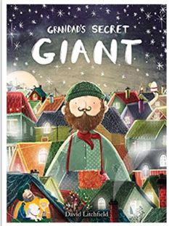
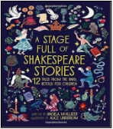

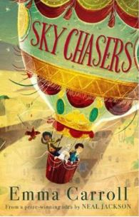

Curriculum Area | Swallows | Robins | Woodpeckers | Magpies |  | Kites
Maths | Addition & subtraction Measurement Money Time Problem solving | Position Direction Multiplication Division Addition subtraction | Length Mass Capacity Shapes Statistics | Decimals Addiiton subtractions Time Perimeter Area Positiion and direction | Area Volume Shape Time Statistics | Secure Fractions, Decimals and Percentages Secure Algebra Secure Ratio and Proportion Secure Geometry
English Writing | Fiction: To write a new version of the story with a new character or new setting | Fiction: To write own version of the story with a focus on morals and acceptance of others | Non-fiction: Write a guide | Non-Fiction: To write an information text about Jean-Michel Basquiat suitable for an art gallery |  | Fiction: To write the next chapter of Sky Chasers in the style of the author from two different viewpoints
English Reading Spine | Shifty McGifty & Slippery Sam | The Magic Faraway Tree | The Worst Witch | Wonder |  | Treasure Island by Robert Louis Stevenson
Science | Materials (ext unit) Waterproof Magnetic materials Floating and sinking | Plants (ext unit) Conditions for growth | Plants Conditions for growth Parts of a flower Water, minerals and nutrients Pollination Photosynthesis Seed Dispersal Famous botanists | Animals including Humans The Human Lifecycle Development of a foetus Gestation Mental Health Puberty |  | Living Things and their Habitats Classification The seven levels of Linneaus’ System Taxonomy Viruses, Bacteria, Fungi Famous Scientists: Jenner and Fleming

Slide 34
Curriculum Area | Swallows | Robins | Woodpeckers | Magpies | Kites
Geography | Weather What symbols do we use to represent different weathers? How does the weather effect people’s lives? | Local areas and maps How can I use a map to help me get around my local area? | Volcanoes How are volcanoes formed? What impact do volcanoes have on the environment? | Fairtrade Why do we need to trade with other countries and explain the benefits of fair trade in less wealthy countries. What are the advantages and disadvantages of trade being global? Consider the impact on natural resources and the environment. | Rainforest How does Brazil’s location of being near a rainforest impact the life of people who live there? How can humans avoid using the rainforest for farming such as cattle grazing and palm oil?
DT | Food and Nutrition: Smoothies | Mechanisms: Making a moving monster | Cooking and Nutrition: Eating seasonally | Cooking and Nutrition: Developing a recipe | Digital World: Navigating the World
Religion and Worldviews | Judaism Tefillah/ blessings Why do Jewish families say so many prayers and blessings. | Judaism Torah / rabbi Why is the Torah such a joy for the Jewish community? | Judaism What symbols and stories help Jewish people remember their covenant with God? | Sikhism How do Sikhs put their beliefs about equality into practice? | Humanism Why do Humanists say happiness is the goal of life?
PSHE | Growing and Changing | Growing and Changing | Growing and Changing | Growing and Changing | Growing and Changing

Slide 35
Curriculum Area | Swallows | Robins | Woodpeckers | Magpies | Kites
Music | Unit: Reflect, Rewind and Replay Style: Western Classical Music and your choice from Year 1 | Unit: Reﬂect, Rewind and Replay Style: Western Classical Music and your choice from Year 2 | Unit: Reflect, Rewind and Replay Style: Western Classical Music and your choice from Year 3 | Unit: Reﬂect, Rewind and Replay Style: Western Classical music and your choice from Year 4/5 | Unit: Reﬂect, Rewind and Replay Style: Western Classical Music and your choice from Year 6
Computing | Programming: Introduction to Animation | Programming: An introduction to quizzes. | Programming: Events and actions in quizzes | Programming: Selection in Quizzes | Programming: Sensing
French | French commences in year 3 |  | Days of the week Tenses – it is, it was, it will be Numbers 0 - 31 Revision of all sentence building | Revise alphabet and spelling names Revise and use adjectival agreement, definite article, correct word order, adverbs of place and new verbs in sentence building To dictate sentences, using correct words for simple punctuation | Revise alphabet and spelling names Revise and use adjectival agreement, definite article, correct word order, adverbs of place and new verbs in sentence building To dictate sentences, using correct words for simple punctuation
PE | Real P.E Ball chasing Floor work Athletics | Real P.E Ball chasing Floor work Athletics | Real P.E Ball chasing Stances Swindon Academy coaching – invasion games | Real P.E Sending and receiving Ball chasing Athletics | Real P.E Sending and receiving Ball chasing Athletics

